Slide 1
Material Handling System

Slide 2
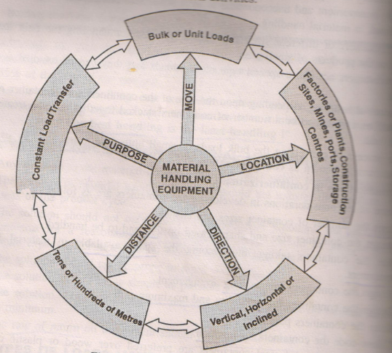
OBJECTIVES OF MATERIAL HANDLING SYSTEM
Accuracy in transportation loads to destination
Precision in picking-up of loads
Transporting loads in scheduled time
Transporting loads of required quantity
Transporting loads without damage
Automation with minimum manpower
Low initial and operational costs
Simplicity and easy maintenance
Operational safety

Slide 3
Conveyor Belt System: Key Part Of Material Handling System
Material handling is an important sector of industry, which is consuming a considerable proportion of the total power supply.
A belt conveyor is a typical energy conversion system from electrical energy to mechanical energy
Today there are different types of conveyor belts that have been created for conveying different kinds of material available in PVC and rubber materials
Belt conveyor has high load carrying capacity, large length of conveying path, simple design, easy maintenance and high reliability of operation.

Slide 4
Classification
Flat Belt Conveyor
Troughed Belt Conveyor
Blanket Belt Conveyor
Woven Wire Conveyor
Chain Conveyor
Apron Conveyor
Screw Conveyor

Slide 5
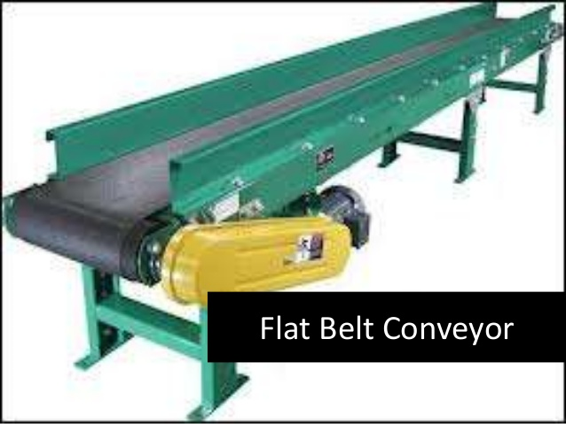

Slide 6
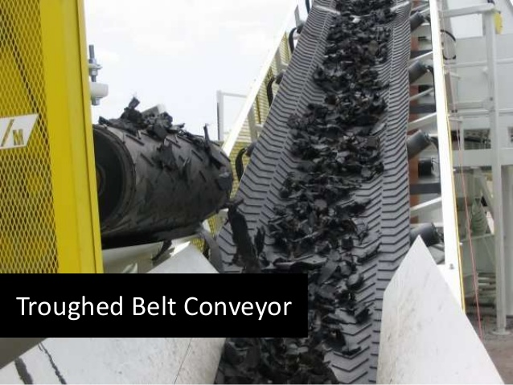
The width of flat belt conveyors limits the
volume carrying capacity.
Trough shape to the belt by means of idlers ,the volume carrying
capacity of the conveyors is increased.

Slide 7
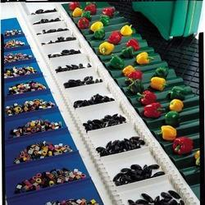
The material on main belt is prevented from sliding down by a blanket belt which is actuated by an auxiliary belt conveyor.
The blanket belt ,which is made up of rubber impregnated construction or welded chain section, offers high flexibility both longitudinally and transversely.

Slide 8
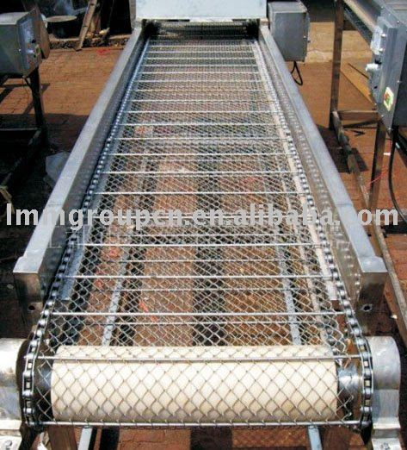
Woven Wire Conveyor Belt
Consist of wire mesh belt woven from stainless steel or
mild steels wires.
As air or liquid can easily pass through the mesh the woven wire belt conveyors are used for carrying materials through ovens , quenching baths washing plants ,drying plants

Slide 9
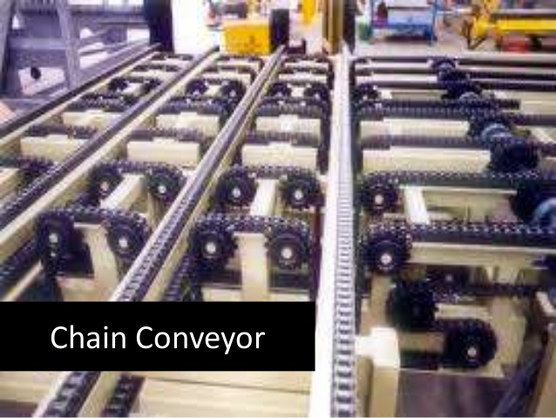
Chain conveyor
Conveyor consist of endless chain running over the drive
or head sprocket and tail sprocket and tail sprocket.

Slide 10
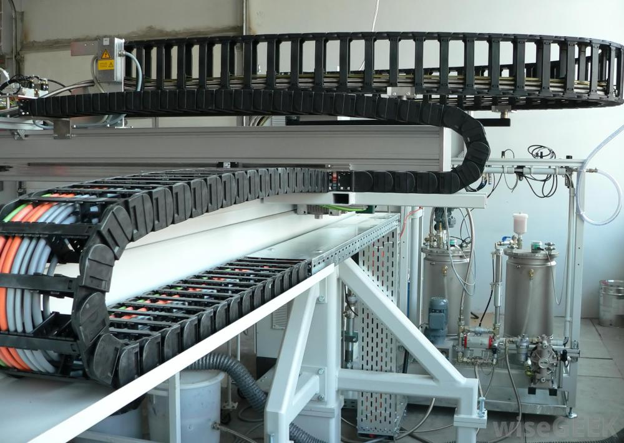
Apron conveyor
The apron conveyor consists of a pair of parallel endless roller chains running on the tracks supported by the frame
The overlapping metals plates are attached to the chains to form a continuous moving bed

Slide 11
Guidelines in selecting conveyor belt system
The following factors are considered while selecting material handling equipment
Direction of Load travel
If the direction of load travel is incline then the conveyor like blanket belt conveyor is preferred. On the other hand if the direction of load movement is horizontal then various types of conveyors belts are used.
2) Length of load travel
If the length of travel is large flat belt and troughed belt conveyors are preferred where as if the length of load travel is small hoists or cranes used
3) Type and properties of load to be handled
Hoisting machines are suitable for unit load; whereas conveyors are suitable for bulk load.the properties of bulk loads are lump size, tendency to form cake, density, temperature, chemical properties

Slide 12
Guidelines in selecting conveyor belt systems
4) Required load moving capacity of unit
If the required load moving capacity is large than the continuous flow type devices like conveyors are used. However if the required load moving capacity is moderate to low than the devices like electrically operated overhead travelling cranes or power driven trucks can be used.
5) Characteristics of Production process
Assembly line and paint shop prefer flat belt conveyors , forging, heat treatment and welding shop employ woven wire belt conveyor and chain conveyors, where as mines use troughed and apron belt conveyors.

Slide 13
Guidelines in designing conveyor belt system.
Principle of optimum space utilization.
Principle of minimum energy consumption.
Flexible to further expansion.
Minimum supervision required.
Ease of maintenance.
Financial feasibility.

Slide 14
The part’s impact::
The make-up of the part can determine what materials are needed for the belt or other conveyor systems. If the part’s surface is a critical component, a change in the hardness of the belt material may be needed to keep the integrity of the part intact
example:
windshields are transported on strand conveyors.
The food industry requires conveyors to be made from materials that pass health code

Slide 15
The process’ impact:
If a change part orientation is critical to the process, the material handling conveyor needs additional equipment to track and locate the part i.e. precision index conveyor .
Another material handling option is a pallet conveyor. Similar to precision index conveyors, pallet conveyors have fixtures for the part to maintain orientation through transportation.

Slide 16
The layout’s impact:
The layout of the conveyor can determine which style of conveyor is needed and the materials used.
Conveyors may need to travel on an incline, a decline or around corners as part of the process.
For inclining traveling belt material should be rough enough to create sufficient friction to withstand gravity force.

Slide 17
Thank you!

